Slide 1
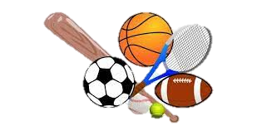
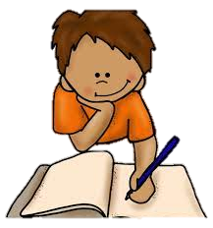


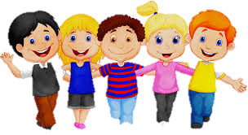
All About Me
Year 7 Health
Lesson 6
2024

Slide 2
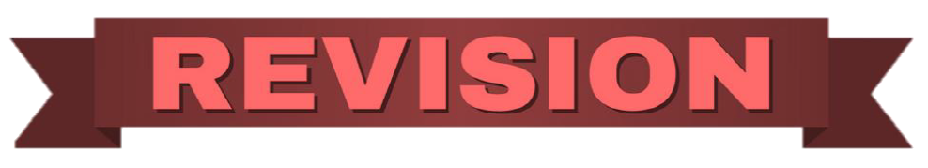
In the first 5 minutes of each lesson you will complete your revision page, you will find these throughout your booklet.
The revision page consists of three questions. It will need to be completed in detail. One word answers will not be accepted.
The three questions :
What two concepts or ideas did I learn in class last week?
What did I find interesting about last week’s lesson? Provide a specific example.
Any questions or new words you have learnt?
The teacher will go over this each lesson with you to see what you have learnt. It is a great way for you to revisit content and test your memory.
Notes:
Pg21

Slide 3

Hook: Post it slam
Different things and experiences affect everyone in different ways, and we all have our own ways of managing these feelings and regulating our emotions.
Everyone will receive a sticky note.
On your sticky note, answer the question and then stick your sticky note on the board.
Names are optional – you can remain anonymous.
Q: When you are feeling emotional, how do you manage and regulate your emotions?
Notes:
Equipment needed – sticky notes.

Slide 4
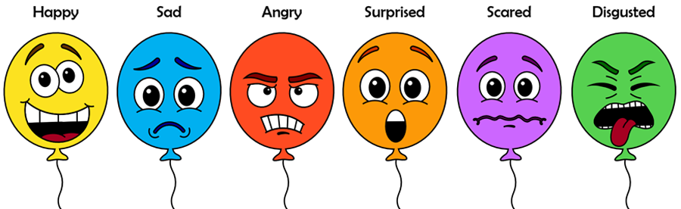
Activity 1: Emotional regulation (Pg. 22).
Managing and expressing emotions in a healthy way
It is important to have strategies for managing and expressing emotions in a healthy way. These can include:
Deep Breathing: Can help calm the nervous system and reduce feelings of stress or anxiety. Focus on taking slow, deep breaths, inhaling through the nose and exhaling through the mouth.
Mindfulness and Meditation: Can promote self-awareness and help individuals observe their emotions without judgment.
Physical Exercise: Regular physical exercise releases endorphins, which are natural mood-boosting chemicals in the body. Engaging in activities like walking, jogging, dancing, or yoga can help reduce stress and improve overall emotional well-being.
Journaling: Writing down thoughts and emotions in a journal can be a therapeutic outlet for processing and expressing emotions.
Notes:
Assessment 2 related
Fill in the blanks

Slide 5
Activity 1: Emotional regulation (Pg. 22).
Managing and expressing emotions in a healthy way
Talking to Supportive Others: Seeking support from trusted friends, family members, or mental health professionals can provide an opportunity to express emotions in a safe and supportive environment.
Engaging in Creative Outlets: Participating in creative activities, such as art, music, or writing, can serve as a means of emotional expression.
Taking Breaks and Self-Care: Recognizing when emotions become overwhelming and taking intentional breaks can be beneficial. Engaging in self-care activities like taking a bath, reading a book, or engaging in hobbies can provide space for emotional rejuvenation and self-nurturing.
Notes:
Assessment 2 related
Fill in the blanks

Slide 6
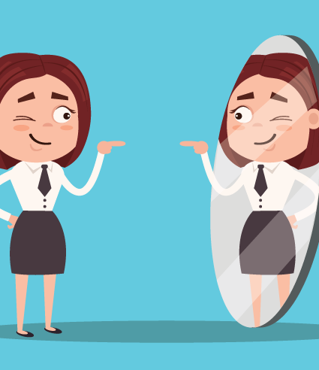
Positive self –talk (Pg. 23).
Positive self-talk refers to the practice of using supportive and encouraging language to oneself during challenging situations or when facing setbacks.
It involves:
    Consciously replacing negative or self-defeating thoughts with positive and empowering ones.
    Building resilience by providing individuals with a constructive internal dialogue that fosters optimism, motivation, and resilience.
Here's how positive self-talk relates to building resilience:
    Building Self-Confidence
    Managing Stress and Adversity
    Overcoming Setbacks
    Boosting Motivation and Persistence
Notes:
Assessment 2 related
Fill in the blanks

Slide 7
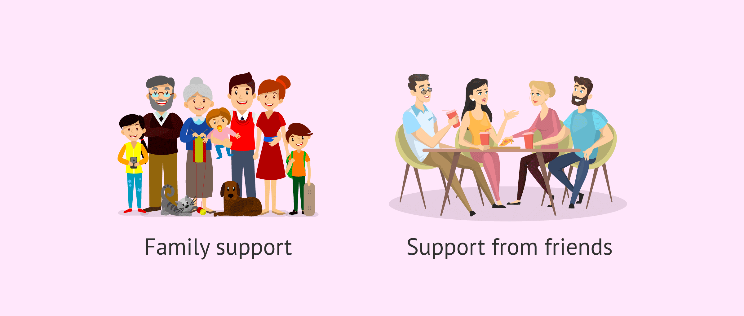
Building Social Support: (Pg. 23).
Friends and Peers:
  Building social support among friends and peers is crucial for emotional well-being.
Family Support:
  Strong family relationships contribute to resilience.
Mentors and Role Models:
  Mentors and role models play a significant role in providing guidance, advice, and support.
Supportive Communities:
  Being part of supportive communities, such as clubs, sports teams, or cultural organizations, can foster resilience.
Professional Support:
  Seeking professional support from counsellors, therapists, or support groups can be instrumental in building resilience.
Building social support is important for our resilience as it helps us to create a supportive network for ourselves for when we need help. Our support network can include:
Notes:
Assessment 2 related
Fill in the blanks

Slide 8

Activity 2:
Who is your support network? (Pg. 24).
BOSS
TEACHER
UNCLE
Helps me at school when I need it.
In the space provided in your book, trace around the outline of your hand.
In the palm area, write your own definition of SOCIAL SUPPORT.
At the tip of each finger, write down a person in your life that you can go to if you need help. Be specific and write their name.
In the space of each finger, write down what kind of support that person can offer you.
FRIEND
MUM
Social Support is:
_____________________________________________
Notes:
This can be an additional activity.
The hand on the slide is an example. Encourage students to write the specific name of the individual. i.e., don’t just write ‘friend’ – write the name of that friend. Encourage students to consider outside their immediate family and friendship group and to not be influenced by what other people write. This is an individual activity for students to realise who in their life they can turn to for support.

Slide 9
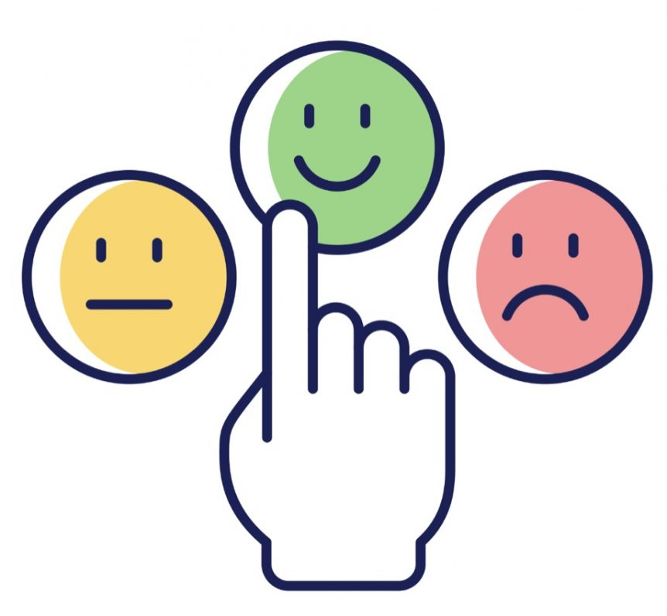
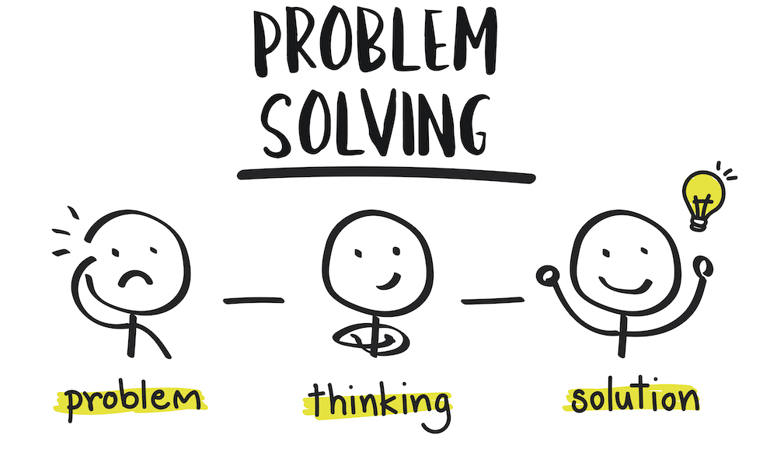
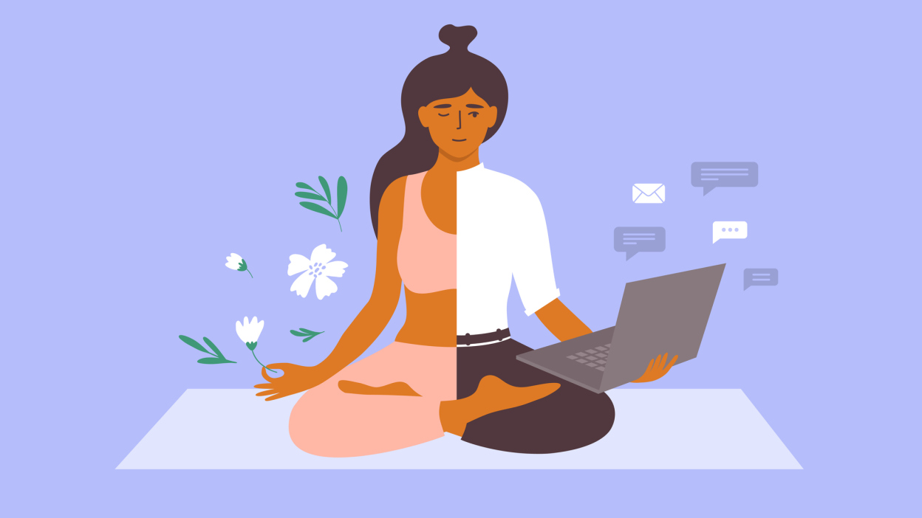
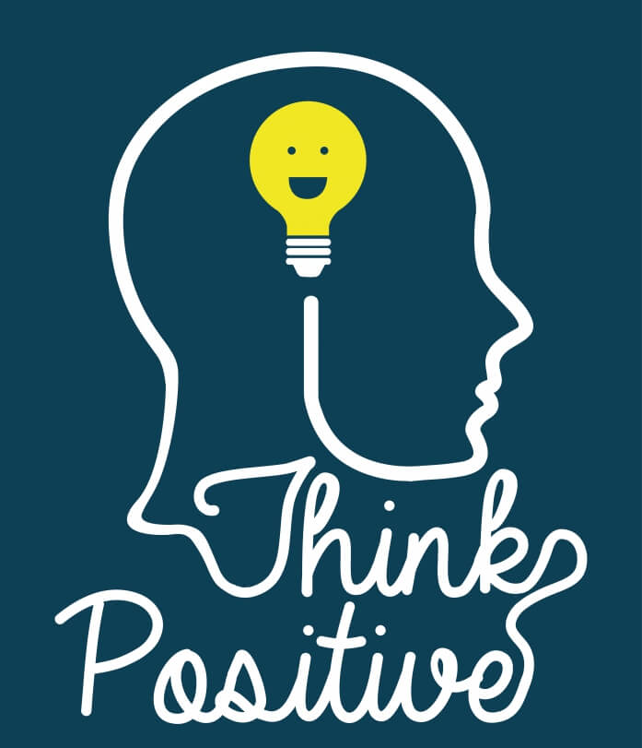

RECAP:
Five Skills of resilience
Understanding Emotions:
The ability to recognize and manage emotions in a healthy and constructive way.
Resourcefulness:
Developing effective problem-solving skills and the ability to adapt to changing circumstances.
Self-understanding:
Knowing your strengths and limitations, what you value, how to show courage and self-reflection, as well as being able to take care of your physical, emotional and mental health and well-being.
Helpful & Positive Thinking:
Cultivating a positive mindset and optimistic outlook, even in difficult situations.
Relationship Skills: Developing and maintaining positive relationships with family, friends, mentors, or support networks.
Notes:
Assessment 2 related
Now that students have learnt the 5 skills of resilience and how to build their resilience skills. It is now time to put them into action. Ask students to recall the 5 skills of resilience before moving onto the next slide/activity.

Slide 10
Activity 3:
Using the
5 resilience skills
(Pg. 25-26)
With all these changes in our lives, we need to employ resilience skills to cope effectively.
Students work individually.
There are 4 scenarios for you to respond to.
You need to respond to each scenario using the resilience skill it is asking for.
We will do one as a class and then you will work to complete the remaining scenarios.
Notes:
Assessment 2 related
Alternative 1: Students work in groups of 4 and each person has a different scenario to complete. Allow time to complete the scenario before students come back together as a group and discuss how they would respond to each scenario.
Alternative 2: Students are divided into groups of 3-4. Each group chooses a scenario and creates a role-play of the scenario and acts out how they would respond to it.
Alternative 3: Students can complete some in class and some as homework if needed.

Slide 11
Activity 3: Example
Using self-understanding to respond to Scenario D
Even though the group are my friends, I don’t feel that they are being fair to Steff. Steff may look different, but it doesn’t mean she is not a great person or a good friend. I don’t believe that leaving Steff out is the friendly thing to do, and I would have the courage to talk to the group to let them know that it wouldn’t be nice if it was done to them. Looking cool is not a value I see in a friend – a friend is someone I can trust and have fun with. I can’t see why we couldn’t do some more activities that would include everyone in the group, so that we all get to know each other better – maybe then the group would understand what the friendship is about. Friends sometimes go different ways, and that is alright, but I think it is important to have a wide circle of friends without judgement of what they look like.
Scenario D:
You have a great friendship group. However, lately they are not wanting to invite you along to outings. This is troubling you as you thought they were your good friends.
Notes:
Pg25

Slide 12

GLOSSARY: (Pg. 5)
At the front of your books is your glossary.
Turn to your glossary and add your own definition for the following words:
      EMOTIONAL REGULATION.
      SOCIAL SUPPORT.
      POSITIVE SELF-TALK.
Make sure your definition consists of at least two sentences.
Notes:
These definitions will be useful for their Assessment Task 2.

Slide 13

EXIT TICKET:
Find someone in the class who has a similar colour hair to you.
Ask your partner:
“What is one thing you will try the next time you need to regulate your emotions?”
Share your answers together.

